Slide 1





Dog Breed Classification using Machine Learning(Transfer Learning)
Team Members:
Guide :Shilpa Hariraj
ADITYA REDDY | 1VE19CS009
RISHEKA RAJESH | 1VE20CA017
MANSI PORAL | 1VE20CA026
GREESHMA M | 1VE20CS045
GURUKIRAN B M | 1VE20CS045
Disclaimer: The content is curated for educational purposes only.

Slide 2
OUTLINE
Abstract
Problem Statement
Aims, Objective & Proposed System/Solution
System Design/Architecture
System Development Approach (Technology Used)
Algorithm & Deployment
Conclusion
Future Scope
References
Video of the Project
Notes:
These are the list of chapters that we are going to cover in these foundation codes. Those are chapter one what are AI and ML? chapter 2 applied Python programming in AI, and chapter 3 is exploratory data analysis for ML.

Slide 3
Abstract
One of the most popular domestic animals is the dog. There are currently around 180 different dog breeds. Each breed of dog has unique traits and health issues. it's vital to identify breeds for proper care and training.
The "Dog Breed Classification using Machine Learning (Transfer Learning)" project aims to develop a sophisticated system for accurately identifying and categorizing dog breeds from images. Leveraging the power of transfer learning, the project utilizes pre-trained deep neural networks to extract valuable features from a vast dataset, enabling the model to generalize well to a specific task with limited labeled data.

Slide 4
Problem Statement
To develop a robust classification system capable of precisely identifying dog breeds from images. Leveraging Convolutional Neural Networks (CNNs) and transfer learning techniques
WHY CNN APPROACH?
Machine learning, a subset of AI, focuses on understanding data structures to create interpretable models. Convolutional Neural Networks (CNNs) stand out in machine learning, particularly in image categorization due to their high accuracy. CNNs use a hierarchical model, facilitating pattern recognition in images by transforming pixel values into interpretable representations. This technology enables computers to classify various data types, including images, sounds, and text.“
WHY TRANSFER LEARNING?
Transfer learning uses pre-trained models on vast image datasets to extract general features, saving time and computational resources.
Also has additional features, Feature Extraction, Improved Performance.

Slide 5
Aim and Objective Aim: This project aims to develop a robust classification system capable of precisely identifying dog breeds from images. Objectives:
The objective of this project is to classifying dog breeds from images Leveraging Convolutional Neural Networks (CNNs) and transfer learning techniques Model Development: Develop a CNN-based model for accurate identification and classification of dog breeds based on images. Transfer Learning Implementation: Utilize transfer learning techniques with pre-trained models (e.g., ImageNet) to extract relevant features and adapt them for dog breed classification.
Practical Applications: such as assisting veterinarians, aiding in animal shelters for breed identification, or supporting dog-related services and industries.

Slide 6
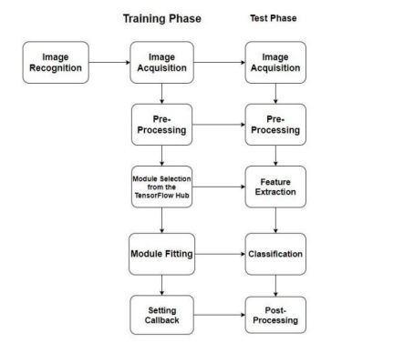
Proposed Solution

Slide 7
We propose a system that helps identify and classify the various dog breeds across the world. Our system uses a pretrained model and Google's TensorFlow hub, which drastically decreases the network's complexity cost and model size.
The system employs transfer learning via TensorFlow hub, a library facilitating the reuse of machine learning model components across different tasks.
Additionally, data batching, splitting a large dataset into 32 batches, optimizes memory usage.
A strong training dataset is a critical first step in creating a robust model.
The dataset is obtained from The Stanford Dogs Dataset , which contains 20K photos of 120 different breeds (200 photographs each breed) 10222 and 10357 photos for training and testing, was used in this project.
Splitting the dataset into Training, testing and validation sets.
Data Augmentation , Data Preprocessing , Feature Extraction is done on the dataset .
Using CNN (Convolutional Neural Network) AND Transfer learning approach in order to Train and Test the model.
Convolutional neural networks (CNNs) are used for feature extraction.
Convolution layers and Pooling Layers are the two basic building blocks that make up the CNN's Convolution section. [2] Convolutional layers add depth by computing the output of local layer-connected neurons. Down-sampling is performed by pooling layers. The feature vectors are extracted from the input photos using CNN.
Transfer learning is a DL technique where the model is built using pre-trained models.

Slide 8
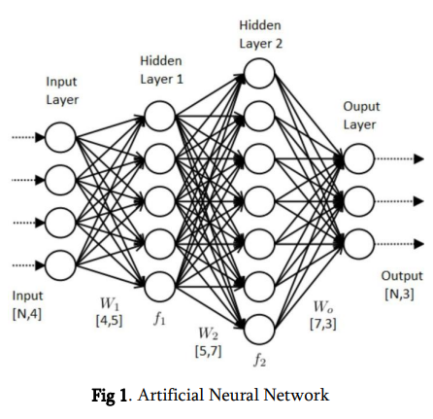
System Architecture
The system architecture comprises three main components:
1.Data Preprocessing: Prepare and augment the dataset for training and testing.
2. Transfer Learning Model: Uses pre-trained models like VGG16, ResNet, or MobileNet, and fine-tune them for dog breed classification.
3. Neural Network: The term "neural network" is often used to refer to an Artificial Neuron Network (ANN).
A neural network is basically divided into three layers: -
Input Layer - All inputs are processed through the model's first layer, known as the input layer.
Hidden Layers - The inputs from the input layers are processed by one or more hidden layers, which may be present.
Output Layer - At the output layer, the data that has been processed is made available.

Slide 9
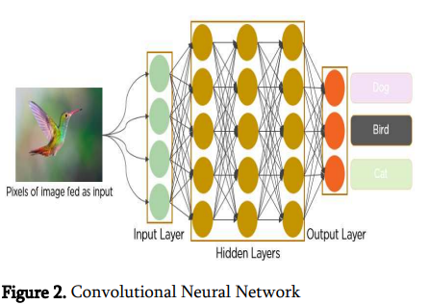
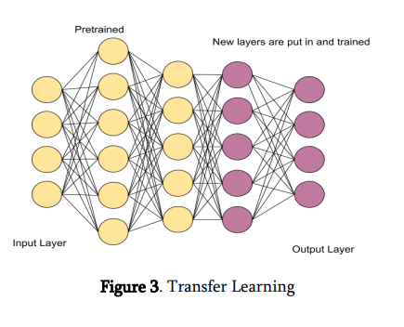
Convolutional Neural Networks (CNNs) play a crucial role in classifying different dog breeds based on their unique traits and characteristics by leveraging their ability to automatically learn and extract features from images. In the context of dog breed classification, CNNs can analyze and identify specific patterns, shapes, and textures within images that are characteristic of different dog breeds. This allows the network to differentiate between breeds based on visual cues such as fur color, ear shape, snout length, and other distinguishing features.
Transfer Learning - Transfer learning is a machine learning method where a model developed for a task is reused as the starting point for a model on a second task. It is a popular approach in deep learning where pre-trained models are used as the starting point on computer vision and natural language processing tasks
TensorFlow: Since it's extensively used for machine learning applications like neural networks, it was chosen as the back-end library for constructing our model. JavaScript and a high-level layer’s API may be used to define, train, and run machine learning models directly within the browser. It is made to manage data that is stored in tensor format.

Slide 10
System Deployment Approach
Programming Language: Python
Framework: Neural Networks, Transfer Learning
Preprocessing: OpenCV, NumPy ,Tensor flow
Input: RGB images of Different dog.
Output: Different Class of Dog breeds.

Slide 11
Algorithm & Deployment
Algorithm:
Preprocessing:
Rescale and resize images: Normalize the brightness and size of all images for consistent input to the model.
Data augmentation: Increase the training set size and improve model robustness by applying techniques like flipping, rotating, and cropping images.
Model Selection:
Transfer Learning: Utilize pre-trained deep learning models like VGG16, ResNet, or Inception, trained on ImageNet (a massive image dataset). Freeze the lower layers (feature extraction) and fine-tune the final layers for dog breed classification. This leverages existing knowledge and reduces training time.
Training:
Loss function: Use categorical cross-entropy for multi-class classification.
Optimizer: Choose an optimizer like Adam or SGD with appropriate learning rate and decay schedule.
Train-validation split: Divide your data into training (80%) and validation sets (20%) for evaluating model performance during training.

Slide 12
4. Evaluation:
Metrics: Track metrics like accuracy, precision, recall, and F1 score on the validation set to assess model performance.
Confusion matrix: Analyze the matrix to identify breeds with high misclassification rates for targeted improvement.
5. Fine-tuning :
If accuracy isn't satisfactory, consider unfreezing more layers in the pre-trained model and fine-tuning them further.

Slide 13
Conclusion
This project demonstrates the effectiveness of transfer learning in automating dog breed classification. The proposed system not only reduces the manual effort required for breed identification but also provides a reliable and efficient solution for this task. The use of pre-trained models enhances accuracy and generalization.

Slide 14
Future Scope
Explore additional fine-tuning techniques for better model performance.
Expand the dataset to include a more diverse set of dog images. Implement real-time classification for dynamic scenarios.
Extend the system to classify other objects or animals beyond dog breeds.

Slide 15
Reference
1] Simonyan, K., & Zisserman, A. (2014). Very Deep Convolutional Networks for Large-Scale Image Recognition.[2] He, K., Zhang, X., Ren, S., & Sun, J. (2016).
2. Deep Residual Learning for Image Recognition.[3] Sandler, M., Howard, A., Zhu, M., Zhmoginov, A., & Chen, L. C. (2018). MobileNetV2: Inverted Residuals and Linear Bottlenecks.
3. Breakthrough Conventional Based Approach for Dog Breed Classification Using CNN with Transfer Learning, Punyanuch Borwarnginn; Kittikhun Thongkanchorn; Sarattha Kanchanapreechakorn; Worapan Kusakunniran,2019 11th International Conference on Information Technology and Electrical Engineering (ICITEE)
Journal URL : https://ijsrst.com/IJSRST229690
Notes:
Reference
These are the references for this session.
15

Slide 16
Thank you!
Notes:
thank you very much for joining this PPT, keep learning.
16

